Slide 1
Science At Your Library
Presenter: Sonia Gustafson
Spokane County Library District
October 29, 2013

Slide 2
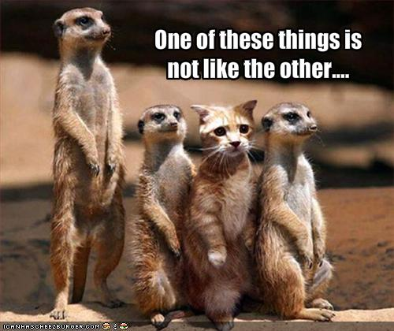

Slide 3
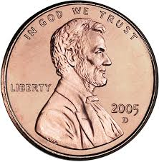
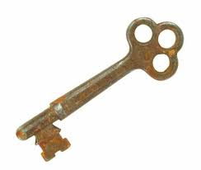
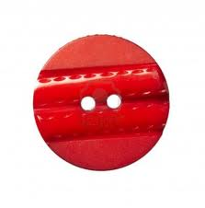
Let’s get acquainted!
Who has a penny?

Slide 4
Objectives/Plan
S.T.E.M.
Core Concepts of Science
How can the library be involved?
Program Ideas
Mother Goose Science: http://www.mothergooseprograms.org/math_science.php
Notes:
Doesn’t all have to be getting grants for expensive partnerships- those are great too. Today will focus on easy, cheap, fun ideas to do right away.

Slide 5
S.T.E.M. Why does it matter?
- That's where the jobs are, and they are higher paying jobs.
- The U.S. is failing to produce enough STEM workers.
- American students are not keeping up with their peers around the world.
- 2/3 of 4th graders are not proficient in Science.
Notes:
S.T.E.M. stands for Science, Technology, Engineering and Mathematics. But S.T.E.M. programming is more than just helping kids discover new facts about the world around them. It is about promoting a deeper understanding of concepts and scientific practices with your kids at your library.

Slide 6
"The main goal of STEM education is not for students to become mathematicians, scientists, technicians, or engineers; although it would be great if more of our youth had such aspirations. The goal is for all students to be able to function and thrive in our highly technological world--that is, to be STEM literate.”
-Jo Anne Vasquez, STEM Lesson Essentials

Slide 7
How do libraries fit in?
“What better place than a library to help provide learning, literacy, and real-world experiences?”
Libraries- that’s where the people are.
-have been providing opportunities for lifelong learning for over 100 years.
-can be places for kids and grownups to create, build, innovate, and learn.
- YALSA’s STEM Programming Toolkit

Slide 8
STEM programming
Connect with community
Partners/options
Grants etc
Make sure the program is positioned in the STEM context- make sure they know that your library is aware of this key educational focus

Slide 9
S.T.E.M. programming is more than just helping kids discover new facts about the world around them. It is about promoting a deeper understanding of concepts and scientific practices with your kids at your library.

Slide 10
Who knew? You are already practicing math and science standards for early childhood
Did you solve a problem today? Sort anything? Make a prediction? Notice changes in the weather? Use your senses? Observe the color, sound or size of anything? Estimate, compare or measure something? That’s science!
Can you count? Add simple numbers? Recognize a pattern? Sort? Make a chart? Write a number sentence (equation)? That’s math!
Notes:
When you read a book to children, do you hold it up and show the cover? The endpapers? Do you talk about the author/illustrator and do you show them that text moves from left to right? Do you ask children to talk about the illustrations? Whether you realize it or not, you're practicing language and literacy standards for early childhood.

Slide 11
“Don’t say you and your staff are not teachers. Think of yourself as an informal educator and your library as a site devoted to supporting lifelong learning opportunities.”
- Phyllis Davis, Matteson Public Library

Slide 12
Scientists are professional question-askers
Connecting
Predicting
Evaluating
Attention Focusing
Measuring, Counting
Comparison
Action
Problem-solving
Reasoning
Notes:
Science isn’t scary!
Connecting- What does that remind you of?
Predicting- what do you think will happen next if?
Evaluating- what do you like about this? What don’t you like? Why?
Attention-focusing- What do you notice about? What is it doing? How does it feel?
Measuring and counting- how many? How much? How heavy?
Comparison- how are they alike? How are they different?
Action- what would happen if?
Problem-solving- how could we..make it taller, stronger, etc?
Reasoning- what do you think? Can you explain that? What makes that happen?

Slide 13
Children learn about Math and Science when…
Repeat actions
Lift things up and look underneath
Ask questions
Use materials and tools in creative ways
Watch things intently
Make predictions
Solve problems
Represent real objects
Make comparisons
Sort objects
Make connections
Notes:
Working on the same puzzle at the library every week
Turns over a rock- what’s that?
Why does the fish make bubbles?
Uses a piece of rope to measure a tower of blocks
Watches the hamster on the wheel
Predicts a raccoon might live in a hollow log
Adds a block to the base of the tower to make it stronger
Two lines- hey it’s a train track
Small blanket for small doll and big blanket for big doll
Button pile- metal and plastic
Make playdough pies like the pies in the book from storytime

Slide 14
EARLs: Science Standards for WA
Systems- how things fit together.
Inquiry- process of asking and answering. The bedrock of science.
Application- interaction between science and technology.
Physical Science
Earth and Space Science
Life Science
Notes:
So what are Science concepts?
Essential academic learning requirements

Slide 15
Science as Inquiry: Children need to practice the process skills of science.
Ask scientific questions
Collect and use data
Communicate information and ideas
Design and make models
Estimate and predict
Experiment
Find patterns
Measure
Notice change over time
Observe
Recognize relationships
Sort and classify
Use simple tools of science

Slide 16
Exploring Science
How do we do all this with kids?

Slide 17
Talk with them
In everyday conversation, use science vocabulary – observe, predict, count, compare
Wonder aloud and ask questions: Will we be able to see the moon tonight?
Allow plenty of time to discuss and observe
Talk about changes you notice in the weather, seasons, the neighborhood
Look for patterns and sequences in everyday activities – What do we do after storytime?

Slide 18
Use Documentation
Have fun making charts and displaying them
Help kids make drawings and books about their investigations
Describe and document changes in themselves, in the library, and in nature
Visit a special tree throughout the year and document similarities and differences

Slide 19
Use tools and technology
Observe and talk about thermometers, calculators, and computers
Measure objects using tools and non-standard objects
Explore with a magnifying glass
Compare weights of different objects by hand, then use a balance
Make shadows with a flashlight

Slide 20
Use Books
Make predictions of what will happen in stories
Display books about science
Look at pictures of insects or animals and talk about similarities and differences
Do an activity/experiment based on a book you’ve read
Stories bring math and science concepts to life, helping children learn about the world around them.

Slide 21
Program Ideas: Patterns
Pattern recognition is the first step in understanding how our world is constructed and how it functions.
Books: Pattern Fish, Jonathan and His Mommy, Spotty, Stripy, Swirly, and The Doorbell Rang.
Activities: Foam shapes, Take-home paper squares, button collection, linking cubes, pattern walk, pattern orchestra, visual/sound/movement patterns.

Slide 22
Program ideas: Shapes, Spaces and Places, and Building and Construction
Geometry- The area of math that involves shape, size, position, direction, and movement.
Books: Round is a Tortilla, I Spy Shapes in Art, Mouse Shapes, My Heart is Like a Zoo, Rosie’s Walk, The Three Little Javelinas, From Cement to Bridge,
Activities: Combining shapes, shape pictures and designs, just one shape, tangrams, obstacle course, map the room with blocks, building with blocks, building bridges, marshmallow engineering.
Notes:
Children begin geometry knowledge by recognizing and naming shapes and forms of familiar objects; windows, doors, wheels etc. The become aware of the position of objects and describ their locations with positional words and phrases. Early geometry experiences help children describe, measure, build, and classify the world around them. They learn best by hands on experiences- anything they can manipulate enhances their understanding.

Slide 23
Program ideas: Elementary School
Marshmallow engineering
Climbing Colors
http://simplystem.wikispaces.com/School+Age+Programs
Speed Racer http://prezi.com/4nxjxd8bkvzu/speed-racer-science/
Lava Lamp

